Slide 1


SUMMER INTERNSHIP PROGRAM 2019
Predicting Patient readmission to the
Hospital using ANN
Team: Code Crackers

Slide 2
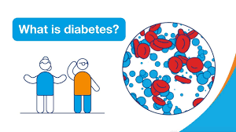
Introduction
Diabetes is a disease that occurs when your blood glucose, also called blood sugar, is too high. Blood glucose is your main source of energy and comes from the food you eat.
Insulin, a hormone made by the pancreas, helps glucose from food get into your cells to be used for energy.
Sometimes your body doesn’t make enough—or any—insulin or doesn’t use insulin well. Glucose then stays in your blood and doesn’t reach your cells.

Slide 3
Introduction (Cont’d)
Over time, having too much glucose in your blood can cause health problems. Although diabetes has no cure, you can take steps to manage your diabetes and stay healthy.
Sometimes people call diabetes “a touch of sugar” or “borderline diabetes.” These terms suggest that someone doesn’t really have diabetes or has a less serious case, but every case of diabetes is serious.

Slide 4
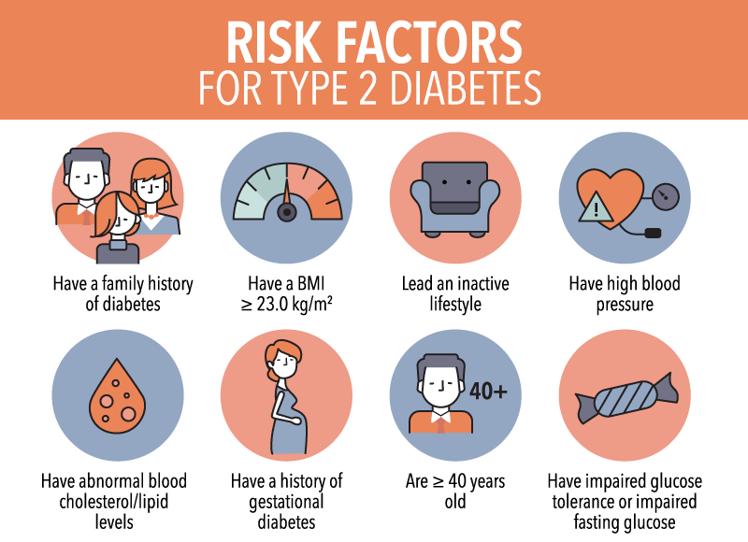

Slide 5
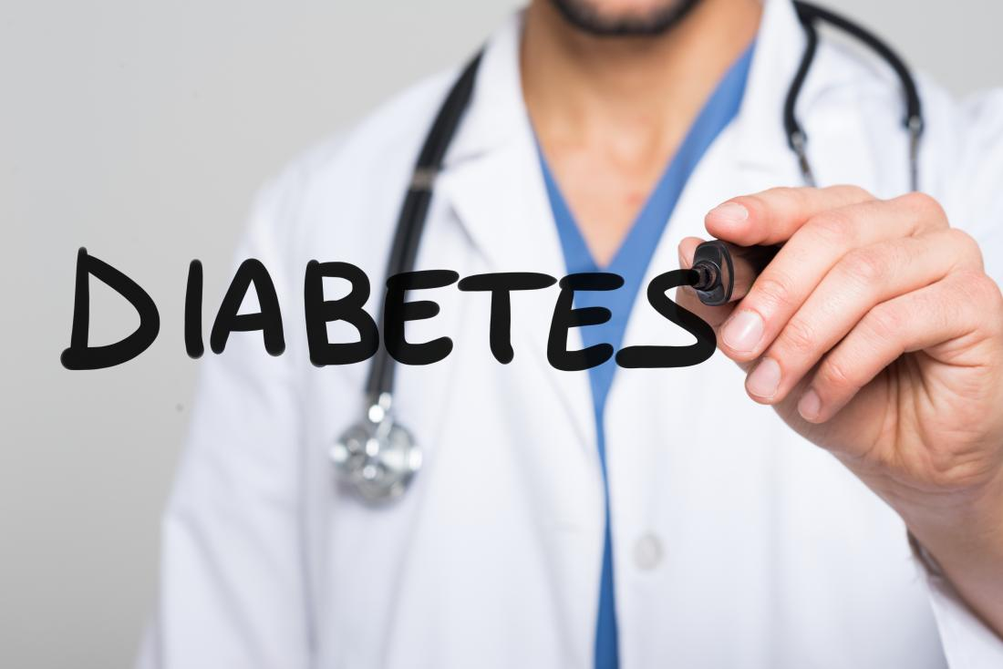
Why predict diabetes readmission
Hospital readmission is a high-priority health care quality measure and target for cost reduction.
By predicting diabetes readmission we can reflect on the quality of health of various patients.

Slide 6

Why predict diabetes readmission (cont’d)
Therefore if we can predict and reduce the 30-day readmissions patients with diabetes , we can greatly reduce healthcare costs while simultaneously improving care.
By predicting the readmissions we can also determine if there is a need for a certain patient to be readmitted or not

Slide 7
What we did in this project
We have used artificial neural network classification for this model
We have collected a dataset containing records of numerous patients and their data
We have performed label encoding on various columns in the dataset

Slide 8
What we did in this project (cont’d)
We were able to train the model to get an accuracy of 58% by using gradient boosting classifier with optimized hyperparameters
We were able to create an application which would predict if a patient had to be readmitted within 30 days or there was no need for readmission
The application was also able to insert the information of any new patient into the database

Slide 9
Procedure and code
First we imported various essential packages for this project such as pandas, numpy, seaborn, matplotlib and keras
Then we read the file diabetic_data.csv into a dataframe called df
We then filled columns which contained a few missing values
If we look at the IDs_mapping.csv we can see that 11,13,14,19,20,21 are related to death or hospice. Hence we removed these samples from predictive model
Then we imported LabelEncoder from sklearn.preprocessing and performed label encoding on various columns in the dataset

Slide 10
Procedure and code (cont’d)
After label encoding, we split the dataset into training set and testing set
We the imported Sequential and and Dense from keras.models and keras.layers to add input , hidden and output layers.
We have used the activation function softmax and in the compiler we used categorical_crossentropy for loss funtion(as we are dealing with categorical values)
We have used the optimization algorithm adam instead of the classical stochastic gradient descent procedure to update network weights iterative based in training data.
Next we trained the model with epochs value as 100
After that we stored the predictive model in y_pred

Slide 11
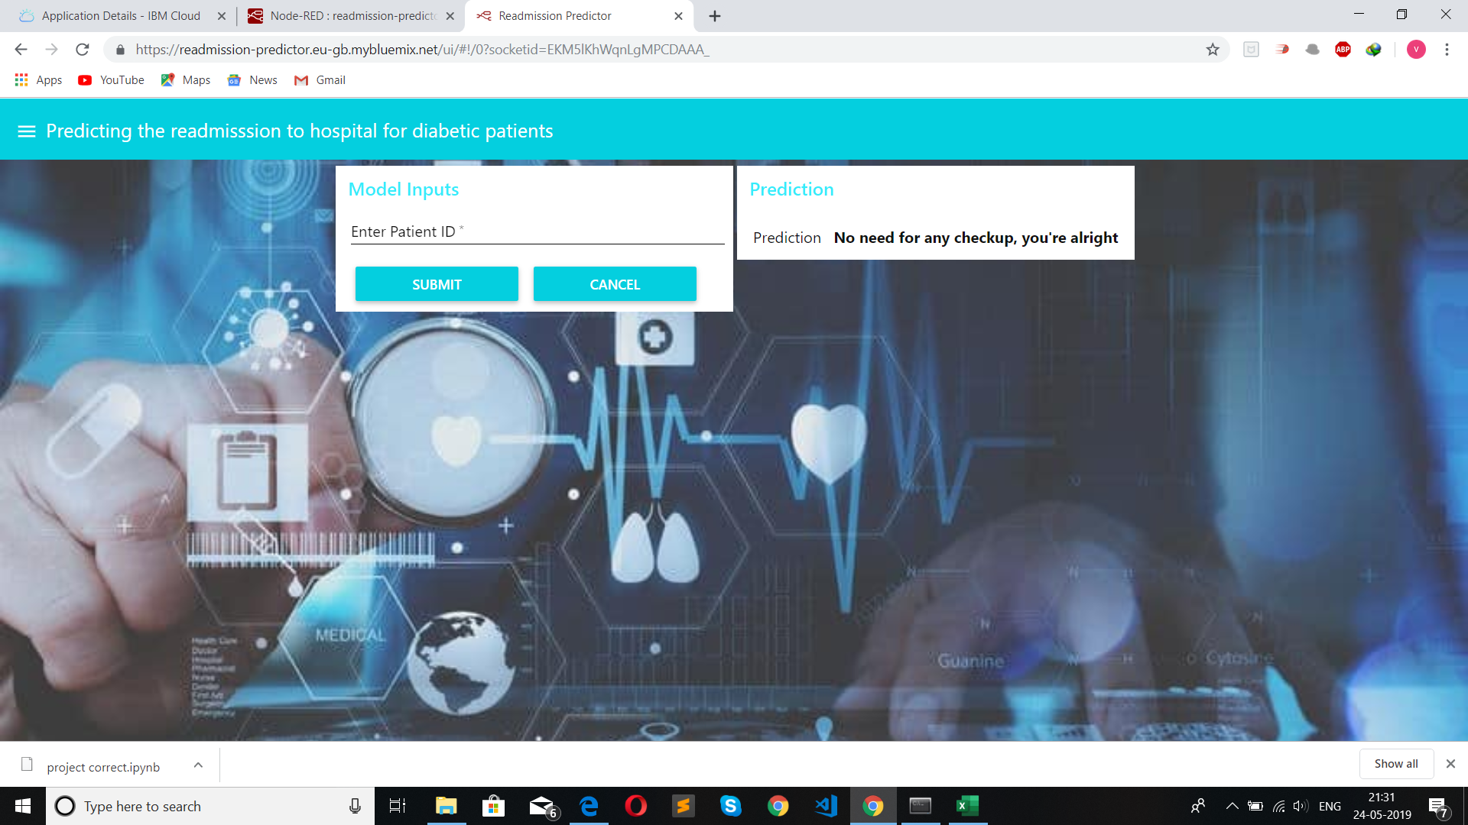
Readmission predictor application
Here we need to mention the patient id and towards the right we get a prediction pn whether the patient needs to be admitted with 30 days or not

Slide 12
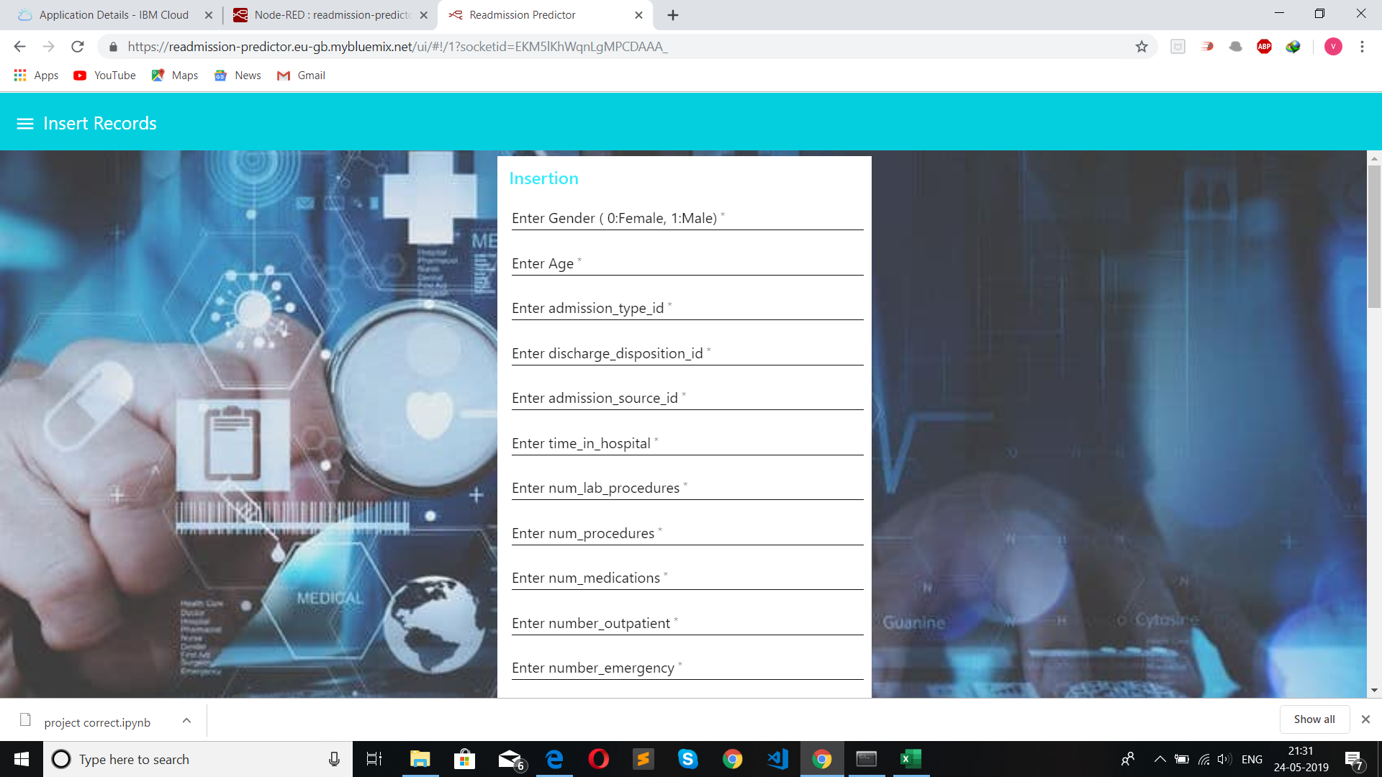
Readmission predictor application (cont)
Here we can insert the records of any new patient

Slide 13
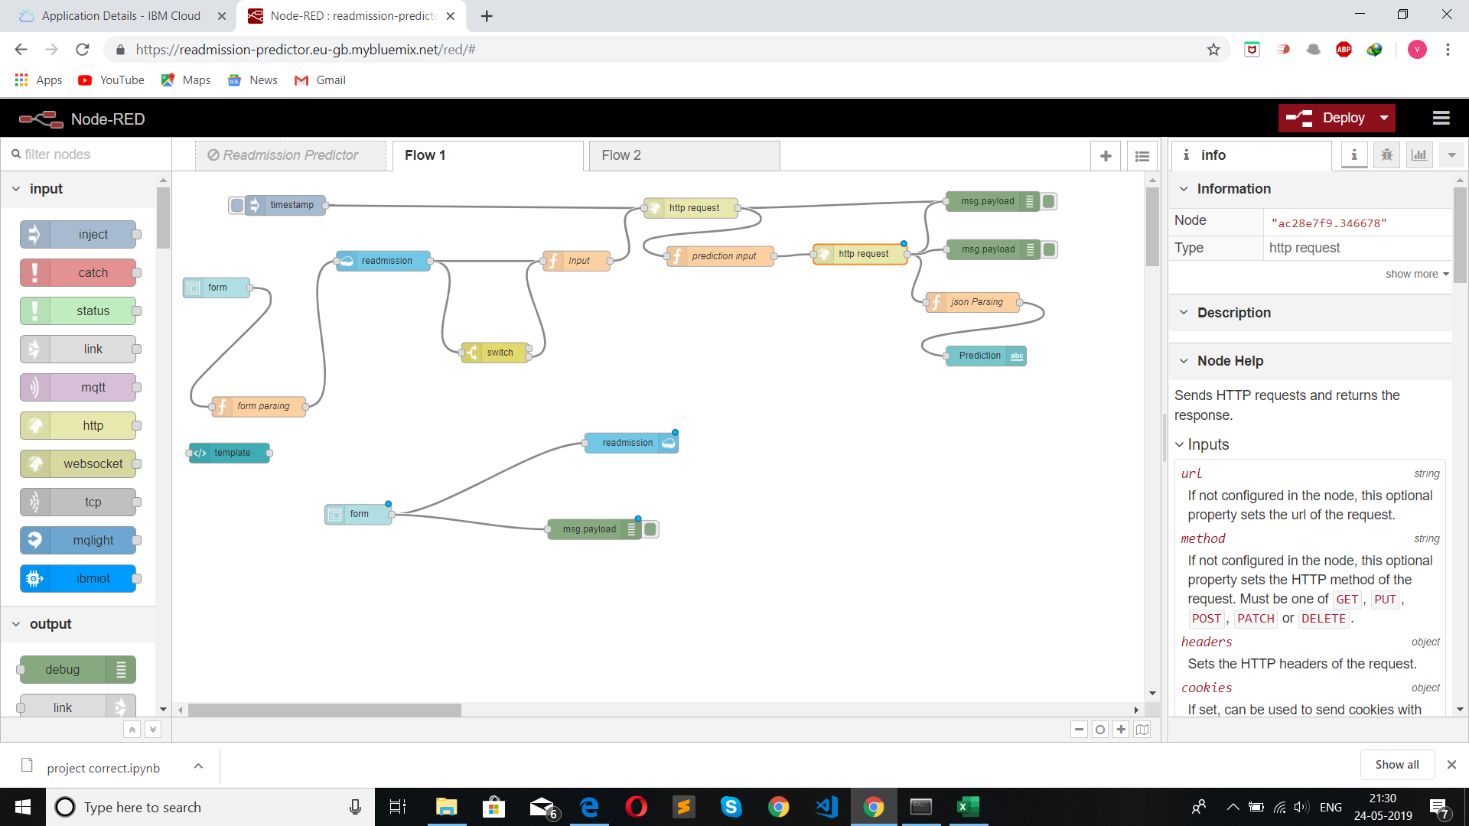
Node-RED flowchart

Slide 14
THANK YOU

